Slide 1
Predicting Avocado Prices with Machine Learning
By: Cesar, Sarah, and Amanuel

Slide 2
Problem..?
Avocado prices are high. Avocado Toast has ruined the economy for Millennials. Will this continue to be the case for Gen-Z?

Slide 3
Methodology
We use Regressive Machine Learning Models to predict avocado prices.
Linear Regression
Neural Network
Decision Tree Regression
Random Forest Regressor

Slide 4
Data
Originates from the Hass Avocado Board.
Our dataset comes from Kaggle:
Vakharia Pujan
Justin Kiggins
Valentin Joseph

Slide 5
Preprocessing
Remove markets
Map regions to markets
Create avocado, region, market, type tables
Save tables as CSVs
Create table schema in PostgreSQL
Import CSVs

Slide 6
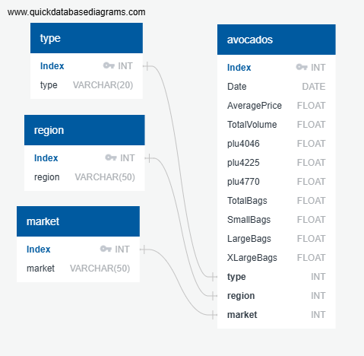

Slide 7
Models
Target Value: average prices
Features:
Plu4046 | Type
Plu4225 | Region
Plu4770 | Market
Total Bags | Quarter

Slide 8
Results
Linear Regression: 0.58
Neural Network: -1.1
Decision Tree Regression: 0.24
Random Forest Regressor: 0.47

Slide 9
In Conclusion
Linear Regression yielded our highest r2 score. This could be explained by our relatively small dataset.

Slide 10
Future Analysis
Future Analysts could consider factors such as:
Size of dataset
Time
Number of features
Using a different Machine Learning Model

Slide 11

The End

